Slide 1
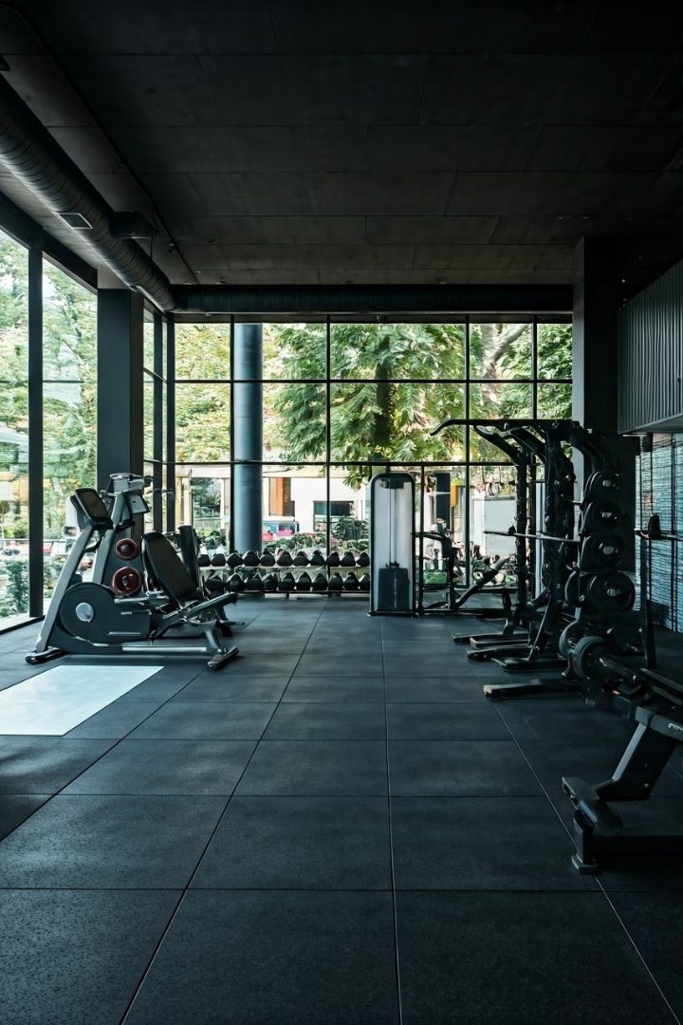
EDA: Body Composition and Workout Routines Analysis for Gym Members to Optimise Physical Fitness
This report delves into an exploratory data analysis of gym members body composition and workout routines. The goal is to identify key factors influencing physical fitness and provide recommendations for optimising the body composition of all gym members.

Slide 2
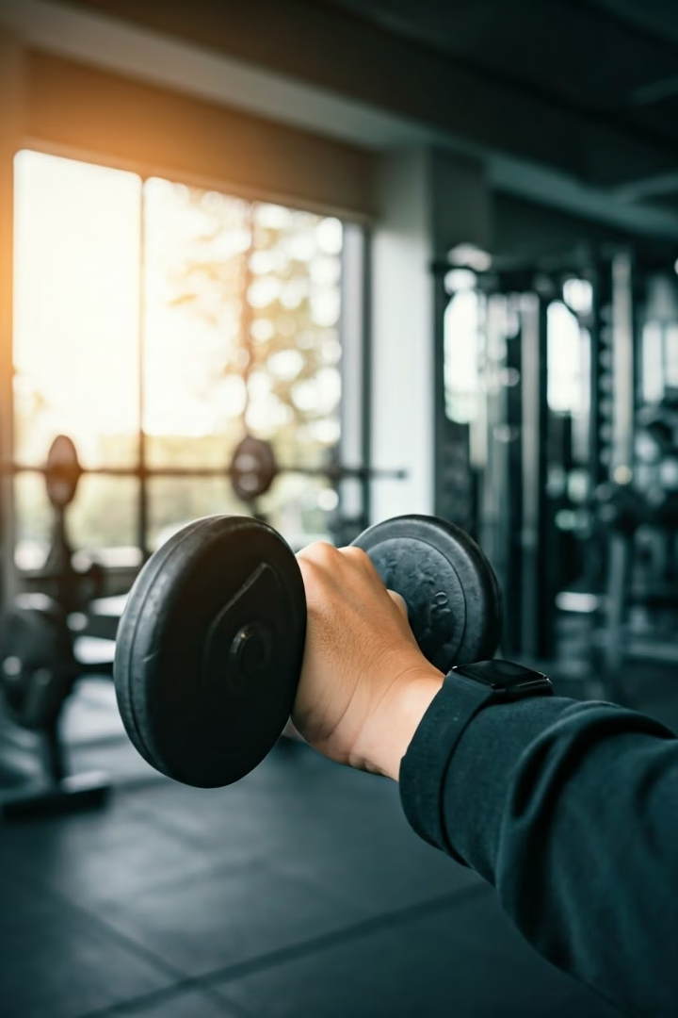
Introduction to the study and its objectives
1
Study Scope
2
Data Analysis
The study aims to understand the relationship between body composition, workout routines, and physical fitness outcomes for gym members.
This involves exploring data collected on members body composition metrics and workout routines to identify key factors influencing fitness.
3
Optimising Workout Programmes
The analysis will provide valuable insights for developing personalised workout routines to enhance gym members' overall body composition.

Slide 3
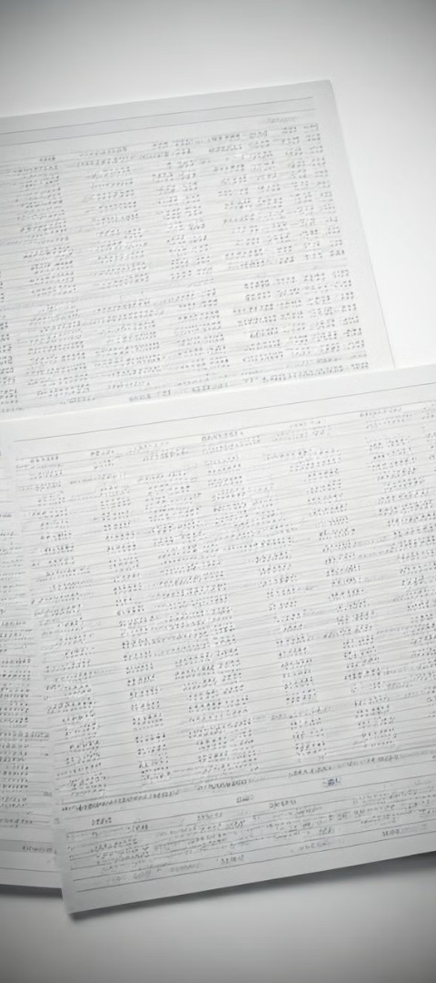
Data collection process and key variables
Source: Gym Members Exercise Dataset on Kaggle
Variable
Description
Age
Member's age in years
Gender
Male or Female
Height
Member's height in meters
Weight
Member's weight in kilograms
Body Fat Percentage
Percentage of body mass that is fat
Body Mass Index (BMI)
It is calculated by dividing a person's weight in kilograms by the square of their height in meters
Workout Frequency
Number of gym visits per week
Calories Burned
Total calories burned during each session
Workout Type
Type of workout performed

Slide 4
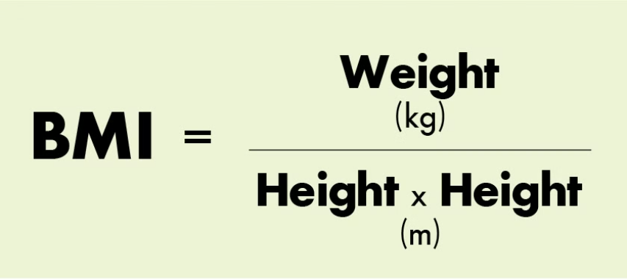
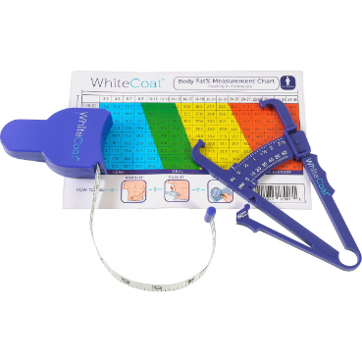
Exploratory analysis of body composition metrics
Body Mass Index (BMI)
The BMI categories are standard for both men and women:
Underweight: BMI < 18.5
Normal weight: BMI 18.5–24.9
Overweight: BMI 25–29.9
Obesity: BMI ≥ 30
Body Fat Percentage
Healthy Body Fat % for Men by Age:
Ages 20-39: 8-19%
Ages 40-59: 11-21%
Ages 60-79: 13-24%
Healthy Body Fat % for Women by Age:
Ages 20-39: 21-32%
Ages 40-59: 23-33%
Ages 60-79: 24-35%

Slide 5

Data Cleaning: BMI and Body Fat Percentage
Incongruent Record Filtering
First of all, creation of a code that identifies and removes inconsistent records from the dataset based on:
BMI and Fat Percentage Mismatch: Eliminates "Underweight" records with high fat or "Obesity" records with low fat.
Unrealistic Values: Filters out entries with extreme fat percentage (<3% or >50%), weight (<30 kg or >200 kg), and height (<1.2 m or >2.5 m).
This ensures the dataset is accurate and reliable for analysis.

Slide 6
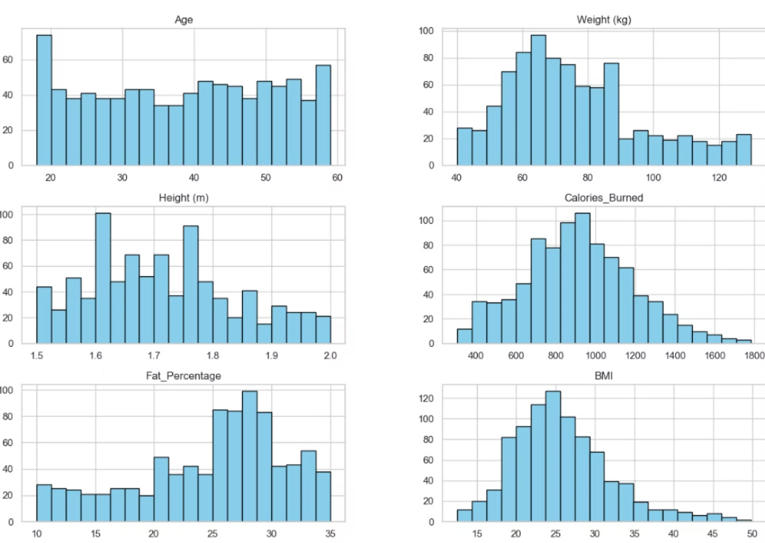
Data Distribution and Removal
The initial dataset contained 973 imputs for each single gym member with it's metrics. Total records removed: 93; Underweight with High Fat: 92; Obesity with Low Fat: 1 , leaving the data distribution aprox. 50% males and females as in origin. Leaving the dataset like this with the main variables we are working on as shown below but Gender and Workout_Frequency (days/week)

Slide 7
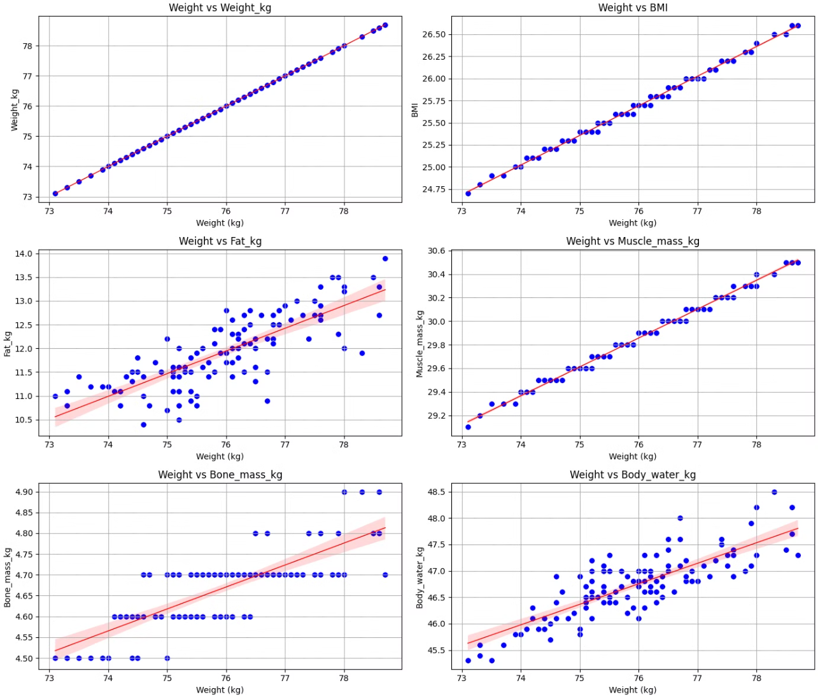
Member Body Composition
Analysis Over 4 Months
This analysis explores the body composition changes over time for a single gym member just to check the relevance and relation of BMI, Weight and Fat as on our dataset we only have single records for each gym member.
Source: [Own registers via Garmin Index S2 scale](https://connect.garmin.com/modern/weight)
The analysis focuses on six key body composition metrics: BMI, Weight body fat percentage, lean body mass, and waist-to-hip ratio, tracked over a period of four months.

Slide 8
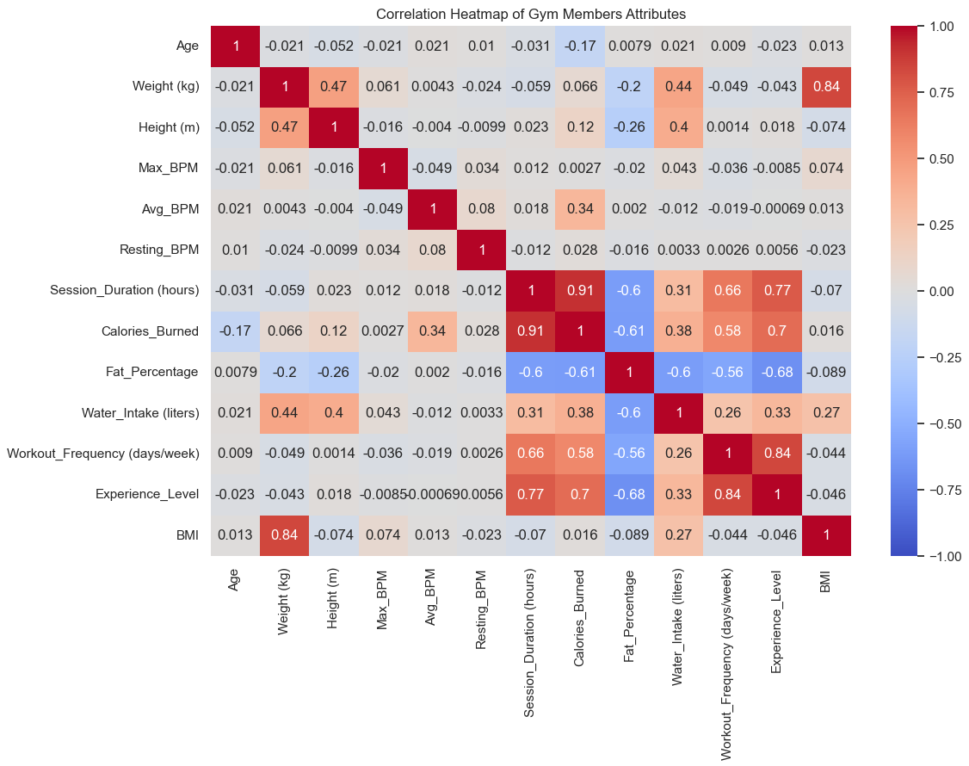
Correlation Matrix for All Gym Members
This correlation matrix analyses the relationship between different body composition metrics for all gym members.
Positive correlations:
BMI – Weight
Experience_Level
Workout_Frequency
Session_Duration
Calories_Burned
Negative correlations:
Fat_Percentage
Workout_Frequency
Session_Duration
Calories_Burned
Experience_Level

Slide 9
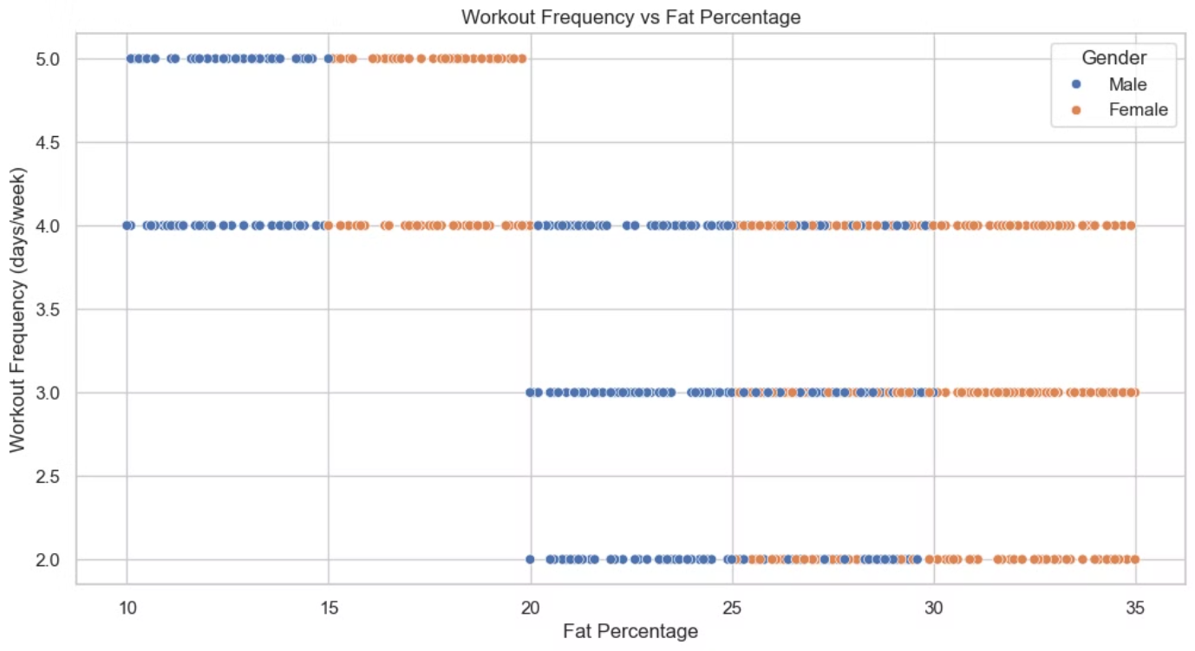
Workout Frequency and Body Fat Percentage
The average body fat percentage tends to decrease with more frequent workouts.

Slide 10
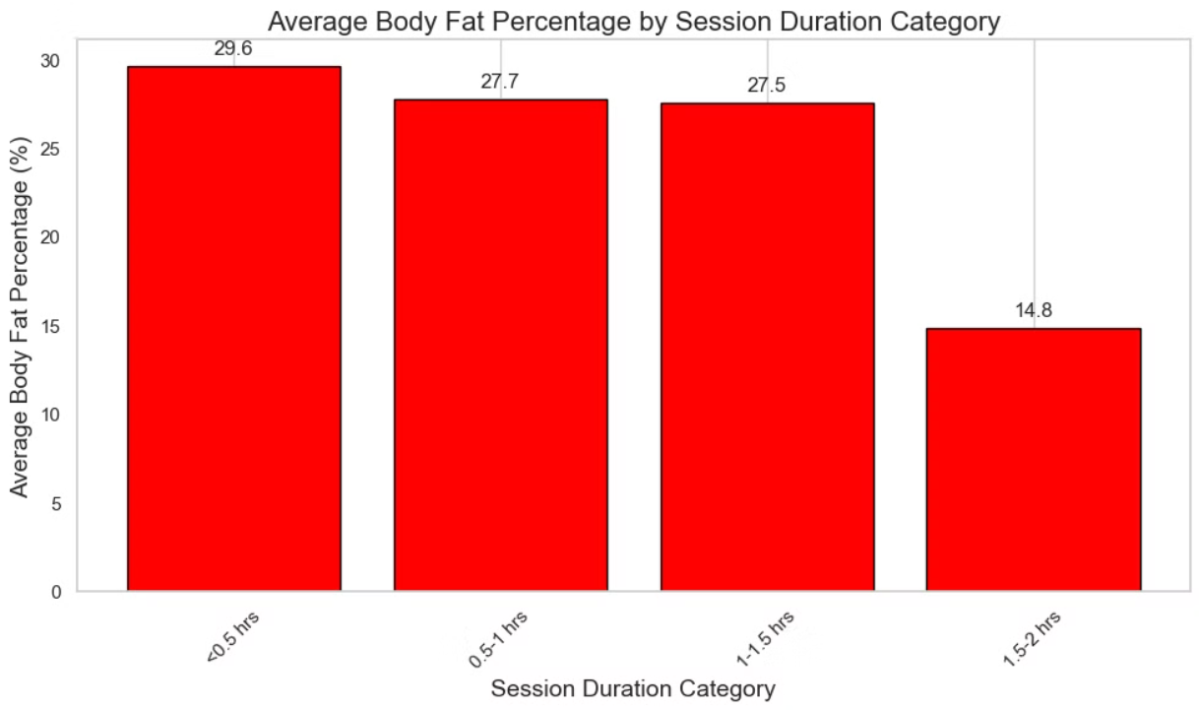
Relationship between Workout Duration and Body Fat Percentage
Members who participate in longer sessions tend to have lower body fat percentage, suggesting a correlation between workout duration and fat reduction.

Slide 11
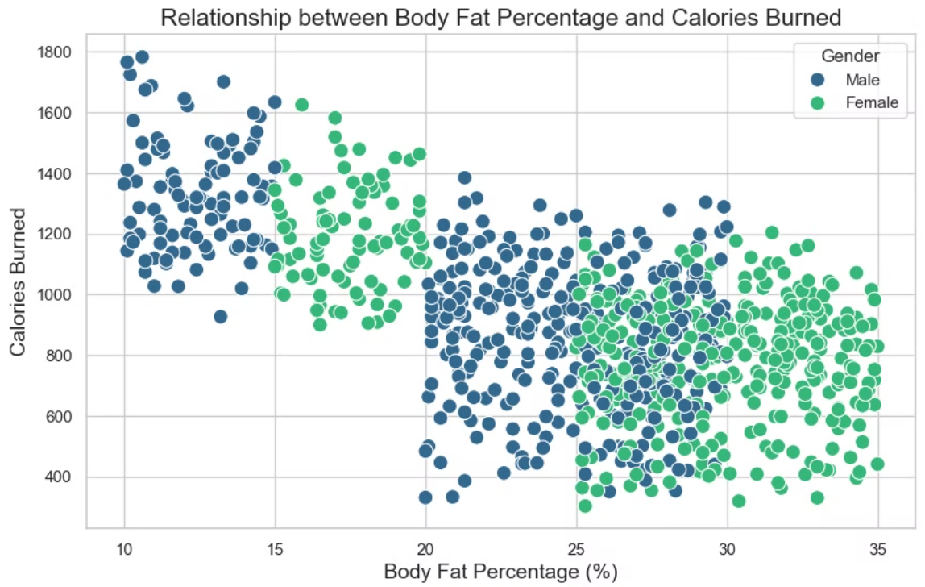
Calories Burned and Body Fat Percentage
This allows us to see how the two are connected and to identify that the intesity of the workout is crucial in lowering the body fat.

Slide 12
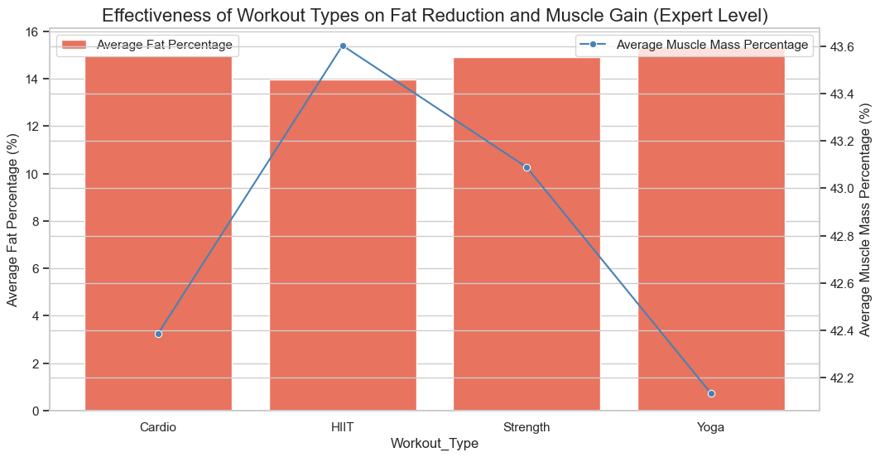
Best workouts to gain muscle and lose fat
The most experienced members of the gym shows us that a combination of Strength and HIIT training are the best options to decrease fat and rise muscle

Slide 13
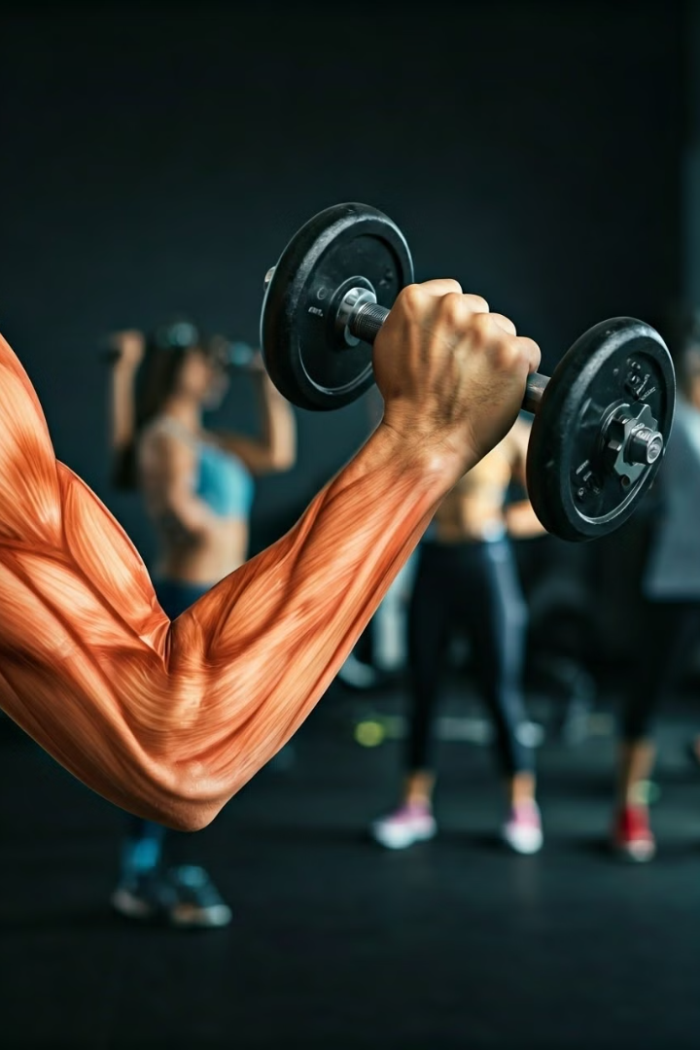



Identifying key factors influencing physical fitness
Workout Frequency
Consistent workout frequency is a significant factor influencing physical fitness, as it provides regular opportunities for calorie expenditure and lowering fat mass. 4-5 days/week
Workout Duration
Longer workout sessions allow for greater calorie expenditure and fat loss, contributing to improved fitness levels. 1,5 - 2 hours/session
Workout Intensity
Higher intensity workouts lead to greater calorie burn and metabolic benefits, resulting in more significant fitness improvements like fat loss.
915 kcal/session at least

Slide 14

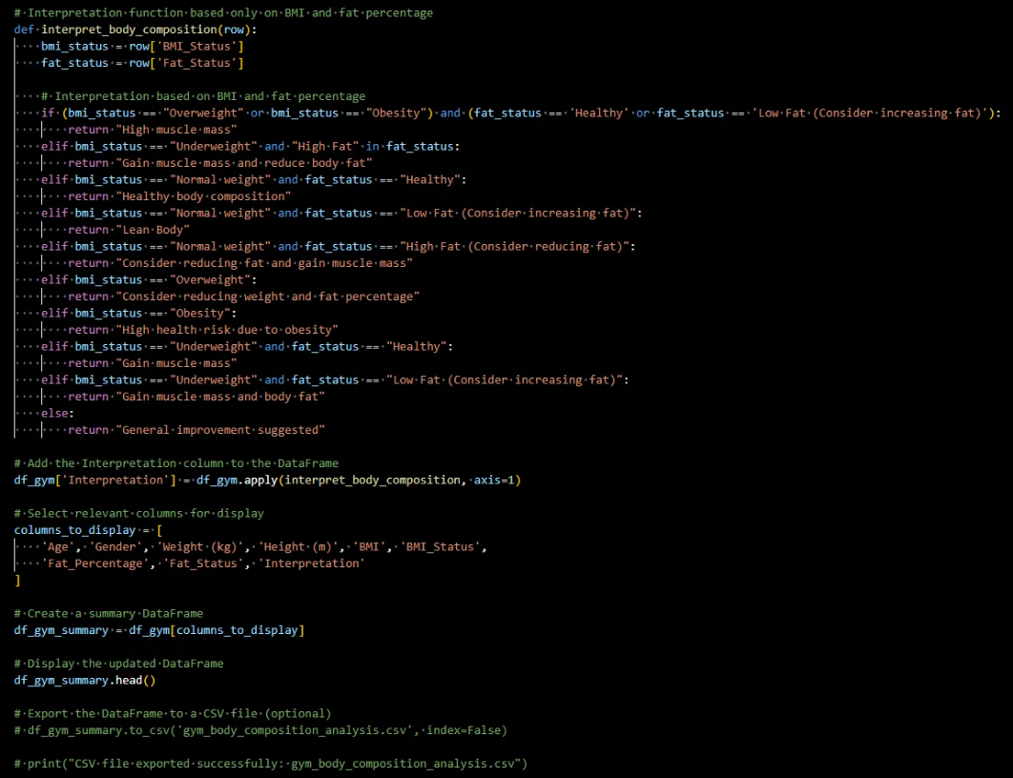
Body composition interpreter and workout advisor for optimising workout routines

Slide 15
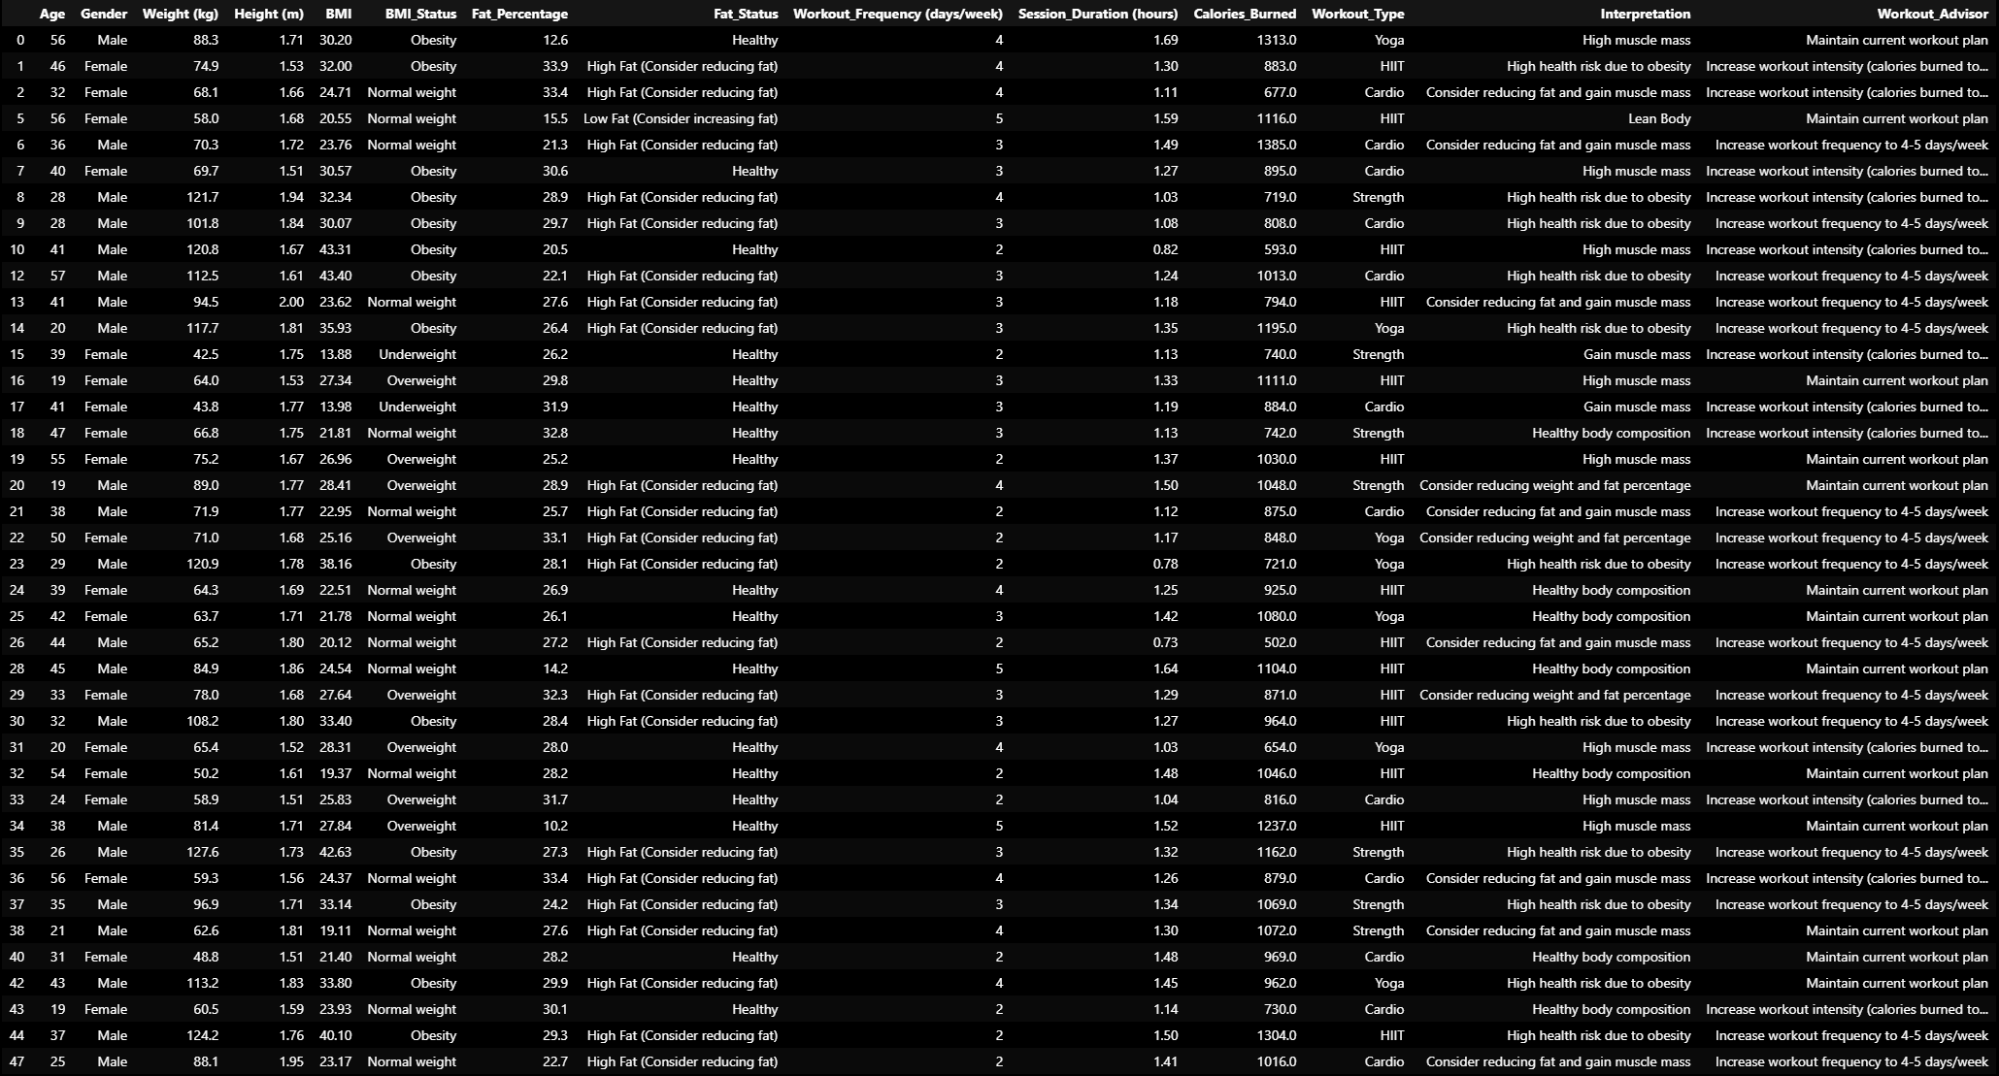

Slide 16
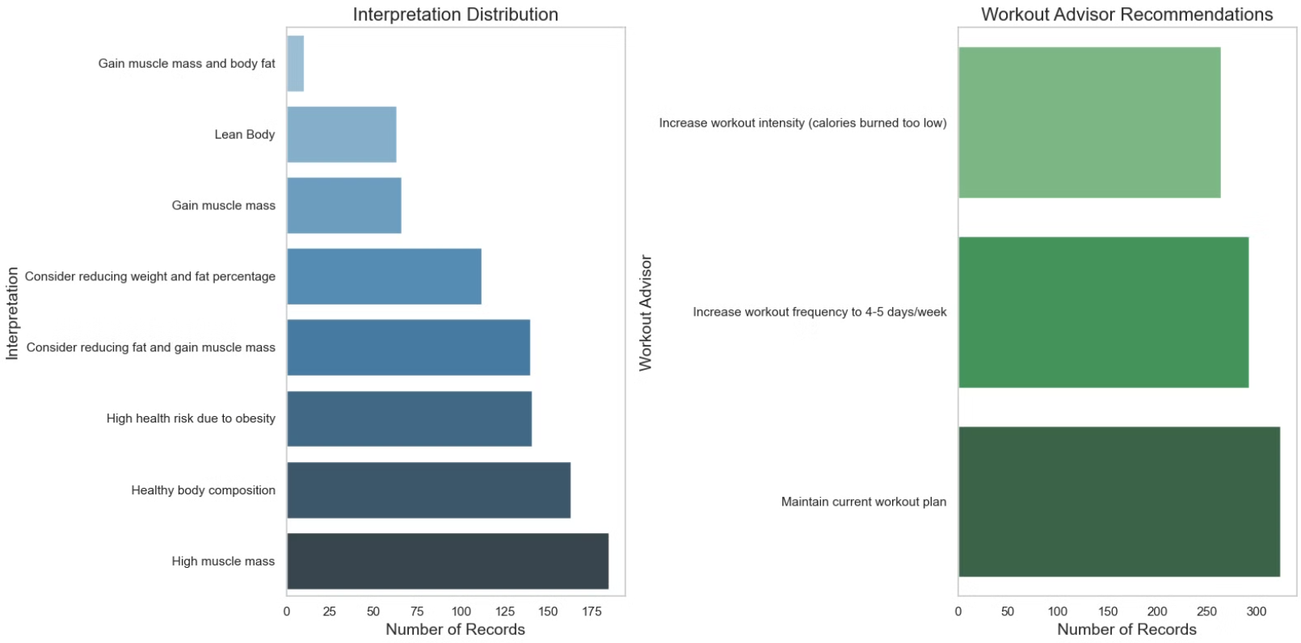

Slide 17

Use cases and development
1
GYM Owners
2
GYM Users
Data-Driven Program Design
Service Optimization
Increase customer engagement
Easily know your physical condition
Adapt their training routine
3
Continued Research
Additional research with larger samples and longitudinal data may predict evolution, maintain user motivation, and increase customer retention.

Slide 18
Thank you for your attention
Source Code and Data
LinkedIn Profile
View the code and data used for this analysis on Github.
Connect with Mikel Telo on LinkedIn to discuss the analysis in more detail.
https://github.com/MikelTelo/eda_for_gym_owners_members
https://www.linkedin.com/in/mikel-telo-a96a371a/

